Slide 1
Types
CS 21a: Introduction to Computing I First Semester, 2016-2017

Slide 2
Types in Java
Recall: variables in Java must be associated with a type such as int or double
e.g., double balance;
In the tester programs we have written, there are variables whose types are classes
e.g., BankAccount b;

Slide 3
Two Kinds of Java Types
Primitive types: one of the 8 built-in types in Java
int, double, long, short, byte, float, char, boolean
variables of primitive types hold values acceptable under these types
Object types: classes
some of these types are "built-in" (present in the Java library) such as String or Graphics, the rest are user-defined such as BankAccount
variables of object types hold references to objects

Slide 4
Understanding Primitive Types
Important components of a primitive data type
range of values
literals (how constant values under the type are written)
operations that can be carried out with values under that type

Slide 5
The int Data Type
Range: -2,147,483,648 to 2,147,483,647
limited range because these are the numbers that can be represented by a 32-bit binary number (4 bytes)
Literals
sequence of digits, e.g., 22, 16, 1, 426, 0, 12900
Operations: usual arithmetic operations
+, -, *, /, % (integer division is performed for / and %)
negative numbers obtained using - as a prefix

Slide 6
Binary Numbers
Humans can naturally count up to 10 values
Computers can only count up to 2 values (OFF and ON, 0 and 1)
Humans use decimal, computers use binary
Example: an 8-bit number is called a byte
b₇ | b₆ | b₅ | b₄ | b₃ | b₂ | b₁ | b₀
0 | 1 | 1 | 0 | 0 | 1 | 0 | 0
2⁷ | 2⁶ | 2⁵ | 2⁴ | 2³ | 2² | 2¹ | 2⁰
In Java, a byte is actually signed and has a range of -128 to +127. The last bit has a place value of -128 instead of 128. More on this in the future...
Range
0 to 2^{n} - 1
01100100₂ = 2⁶ + 2⁵ + 2²
= 64 + 32 + 4
= 100₁₀

Slide 7
The double Data Type
Values: decimal numbers
Range: +/- 4.94e-324 to 1.80e+308
Limited precision: n.nnnnnnnnnnnnnn x 10^{(+/-mmmm)}
even though you can specify up to 10³⁰⁸, you don't actually get 308 digits of precision, just a few (about 15 digits)
again, this is because we are limited to 64 bits or 8 bytes
Literals (examples)
100.5, 0.33333, 200000.0
8E10 (80000000000.0), 2.1e-3 (0.0021)
Operations: arithmetic operations with true division
float: lower precision (fewer digits)

Slide 8
Other Primitive Types
char - represents characters found on the keyboard or printed on an output device
Literals: 'A', 'b', '5', '\n', '\u0009'
values come from the Unicode character set (subsumes the ASCII character set)
boolean - used for conditions
possible values: true or false
more on this when we discuss decision statements

Slide 9
Operations and Numeric Types
most arithmetic operations are binary operations
requires two numeric operands, returns a result
e.g., balance + 100 miles/efficiency
there are some unary operations
unary operators: - ++ --
e.g. negation int value = 10; int negated = -value // assigns -10

Slide 10
Operations and Numeric Types
Arithmetic operations follow precedence rules
negations are performed before multiplcations and divisions, which are performed before additions and subtractions
parentheses can be used to overrirde these precedence rules

Slide 11
Operations and Numeric Types
Operations performed sometimes depend on the types of the operands (e.g., /)
When both operands are ints, integer division is performed (integer quotient returned, remainder discarded)
When at least one operand is a float or a double, real division is performed (returns a floating point number)

Slide 12
Built-in Functions
Provided in Java to support more complex operations
Example 1: Math.pow()
double result = Math.pow( 5.5, 3.0 );
can be viewed as a binary operation that calculates some power of a number
Example 2: Math.sqrt()
double result = Math.sqrt( 2.0 );
can be viewed as a unary operation that calculates the squareroot of the given operand
javap java.lang.Math
prints a list of available math functions
these are static methods (methods called on the Math class)

Slide 13
Expressions
Expression
a sequence of variables, literals, operators, and method calls (like Math.pow())
has a return value and type
Uses
the right operand of an assignment pesos = dollars * 47.47 + fee; ans = Math.sqrt( b*b - 4.0*a*c );
argument for an output statement System.out.println( (-b + ans)/(2*a) );

Slide 14
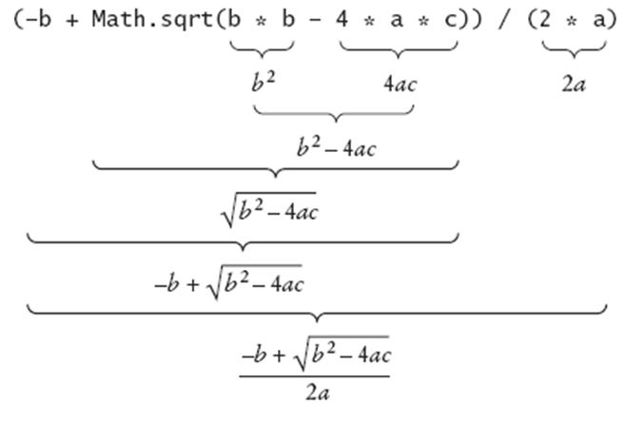
Analyzing an Expression
image taken from Horstmann's lecture notes

Slide 15
Floating Point Values
For double and float types, the value stored or computed is often not exact
Because of binary storage and precision constraints, values are rounded
double num = 4.35; double val = 100 * val; System.out.println( val );

Slide 16
Floating Point Values
We can assign an int value to a double, but not the other way around
int i = 10; double d = 5.0; d = i; // ok, d gets 10.0 // automatic type conversion i = d; // compile error

Slide 17
Casting and Rounding
Use a cast to "force" a conversion
there may be some data/precision loss during the conversion
Syntax: (type) expression
e.g., int x = (int) 5.65; // assigns 5
may be used when converting doubles or floats to longs or ints

Slide 18
Casting and Rounding
Use Math.round() to carry out rounding of floating point numbers to whole numbers
float f = 5.65; double d = 4.44; int i = Math.round(f); // assigns 6 long l = Math.round(d); // assigns 4

Slide 19
Increment and Decrement Operators
Unary operators require one variable as an operand: increment (++) or decrement (--)
Examples
int a = 5; a++; // same as a = a + 1; a--; // same as a = a - 1;
Operator can be placed before the variable:
++a; // same as a = a + 1; --a; // same as a = a - 1;

Slide 20
Post-increment Operator ++
Example: number++
Operands:
unary operator
operand must be a variable
Returns:
the original value of the operand
Effect:
variable is incremented
Note: the variable is incremented after its value is returned

Slide 21
Pre-increment Operator ++
Example: ++number
Operands:
unary operator
operand must be a variable
Returns:
the new (incremented) value of the operand
Effect:
variable is incremented
Note: the variable is incremented before its value is returned

Slide 22
About ++
Notice that a++; and ++a; are similar...
return value is ignored in both cases
could be used as shorthand for a = a + 1;
...but they are not the same!
difference is seen when using the return value a = 5; a = 5; b = a++; b = ++a; // What are the values of a & b?

Slide 23
Constants
Literal values in a program
appear often enough and may be associated with an appropriate name
declare at the level of the methods (right after the opening curly brace for the class) so that it can be used inside any of the methods
Examples (note naming convention)
public static final int MAX = 100;
public static final double PI = 3.1415926;
public static final double DIME = 0.10;

Slide 24
Primitive Type Variables vs. Object Variables
Primitive type variables directly contain values
int x = 5;
Object variables contain references
BankAccount b = new BankAccount();
x
5
b
balance
0

Slide 25
Primitive Type Variables and Assignment
x
int x = 1000;
1000

Slide 26
Primitive Type Variables and Assignment
x
int x = 1000;
int y = x;
1000
y
1000

Slide 27
Primitive Type Variables and Assignment
x
int x = 1000;
int y = x;
y = y - 100;
System.out.println(x);
System.out.println(y);
1000
y
900
Prints:
1000
900

Slide 28
Object Variables and Assignment
BankAccount b = new BankAccount(1000);
b
balance
1000

Slide 29
Object Variables and Assignment
BankAccount b = new BankAccount(1000); BankAccount c = b;
b
balance
1000
c

Slide 30
Object Variables and Assignment
BankAccount b = new BankAccount(1000); BankAccount c = b; c.withdraw(100); System.out.println( b.getBalance() ); System.out.println( c.getBalance() );
b
balance
Prints:
900
900
1000
c

Slide 31
The null reference
Assign null to an object variable to indicate that the variable is currently not referring to an object
Example: b = null;
b
null

Slide 32
Garbage Collection
Because object variables are references, it is possible to have "stale" objects in memory (objects that have no variables that refer to them)
BankAccount b = new BankAccount(100); b = new BankAccount(200); BankAccount c = new BankAccount(300); c = null; /* at this point, only the bank account whose balance is 200 has a variable referring to it */
Stale objects are automatically garbage collected

Slide 33
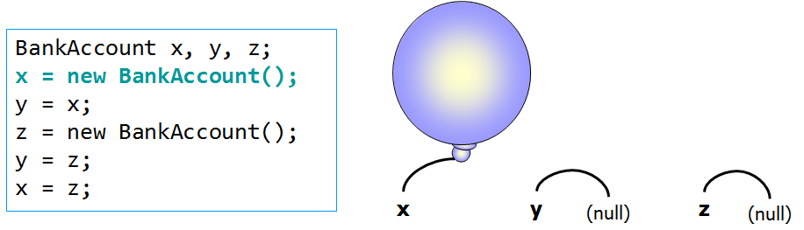
The Balloon Analogy
Think of Objects as balloons!
references are like strings (aka "handles")
this idea is from "Beginning Java Objects" by Jacquie Barker (Wrox)

Slide 34
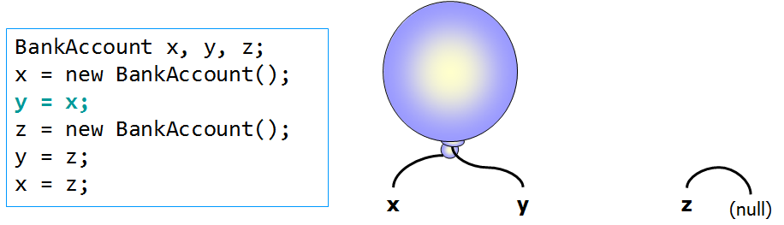
The Balloon Analogy

Slide 35
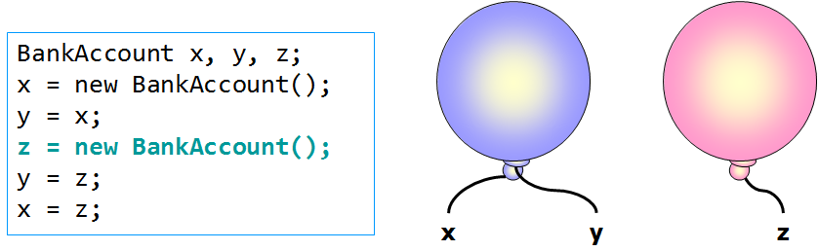
The Balloon Analogy

Slide 36
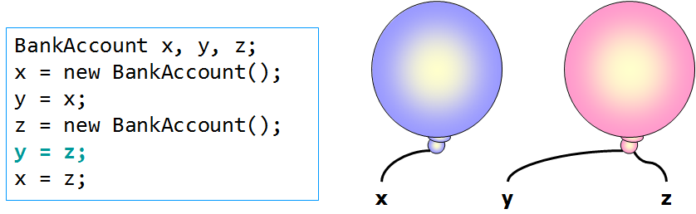
The Balloon Analogy

Slide 37
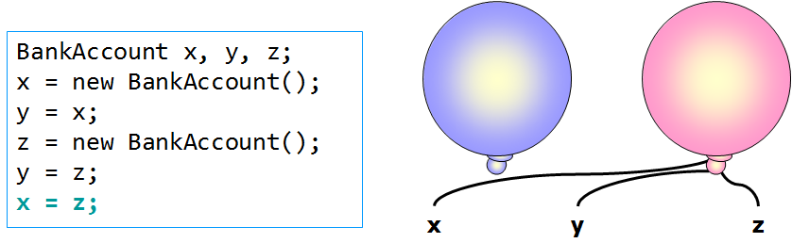
The Balloon Analogy

Slide 38
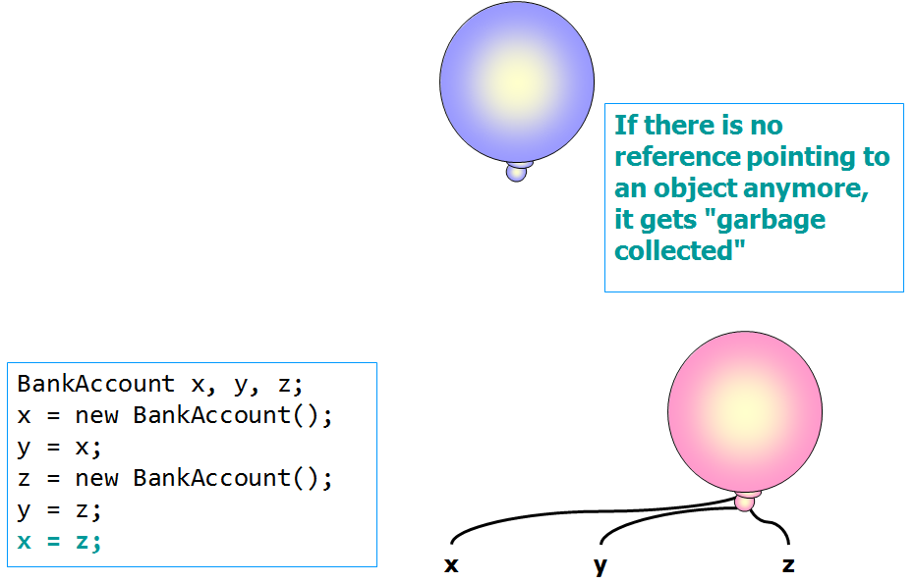
The Balloon Analogy

Slide 39
Method Calls
A method is invoked on an object variable but acts on the object that the variable is referring to
BankAccount b = new BankAccount(1000);
b
balance
1000

Slide 40
Method Calls
A method is invoked on an object variable but acts on the object that the variable is referring to
BankAccount b = new BankAccount(1000);
b.deposit(250);
b
balance
1000
deposit(250)

Slide 41
Method Calls on null
Calling a method on an object variable whose value is null results in an error (NullPointerException)
b
null
BankAccount b = null;
b.deposit(250);
deposit(250)
???

Slide 42
The String Class
String: a built-in class in Java
Methods on String objects:
javap java.lang.String for a complete list
public int length()
public String toUpperCase()
public String substring( int first, int last )
Note: Strings are immutable (no mutator methods)
String objects have a special treatment in Java
To enable String literals, String display, and String concatenation

Slide 43
Using Strings
String literal: "Hello, World"
String variable: String message = "Hey"; // same as String message = new String("Hey");
Using Strings System.out.println("Hello, World"); System.out.println(message); System.out.println(message.length()); String caps = message.toUpperCase(); System.out.println(caps);
Prints:
Hello, World
Hey
3
HEY

Slide 44
Strings are Objects
String variables contain object references
String s = "Hey";
Calling length() on a String returns an int. int x = s.length();
s
"Hey"
3
length()
"Hey"

Slide 45
Strings are Objects
Calling toUpperCase() on a String returns another String String caps = s.toUpperCase();
Note that the state of the String object does not change in this case
toUpperCase()
"Hey"
"HEY"

Slide 46
String Concatenation
Recall that operators may behave differently depending on the type of the operands
The + operator causes a concatentaion if the operands are Strings
System.out.println("basket"+"ball");
If only one operand is a String, the other operand is first converted to a String and then a concatenation is performed
int ans = 5; System.out.println("The answer is " + ans);
Prints:
basketball
Prints:
The answer is 5

Slide 47
Converting between Strings and Numbers
Suppose int i = 5; double d = 10.0; String s = "7";
From String to number
i = Integer.parseInt(s); // assigns 7 to i
d = Double.parseDouble(s); // assigns 7.0 to d
From number to String
s = Integer.toString(i); // assigns "5" to s
s = Double.toString(d); // assigns "10.0" to s
Can also use concatenation s = "" + d;

Slide 48
The substring Method
public String substring(int first, int last)
Each character in a String object has a position (starting with 0); the parameters for substring indicate:
first: the starting letter of the substring of interest
last: the position following the ending letter of the substring
This way, (last-first) = the length of the resulting substring
Example String s = "Ateneo de Manila"; String a = s.substring(0, 6); // "Ateneo" String b = s.substring(6, 9); // " de" String c = s.substring(10, 16); // "Manila"

Slide 49
Reading Keyboard Input and the Scanner
To enable keyboard input:
Before the declaration of the application class, type: import java.util.Scanner;
At the beginning of the main method of the Java application, define a Scanner object: Scanner in = new Scanner( System.in );
Then, invoke methods on the Scanner object
int i = in.nextInt(); double d = in.nextDouble(); String s = in.nextLine(); // reads an entire line of input String w = in.next(); // reads one word only

Slide 50
Input Example
import java.util.Scanner;
public class DollarToPesoConversion
{
public static void main( String args[] )
{
Scanner in = new Scanner( System.in );
System.out.print( "Type dollar amount: " );
int dollars = in.nextInt();
System.out.print( "Conversion rate: " );
double rate = in.nextDouble();
System.out.print( "Pesos: " ); System.out.println( dollars * rate );
}
}

